Slide 1
Belarus–China Relations:
A Synthesis of Narratives
By Peter Braga
February 25, 2017

Slide 2
This presentation covers the four narratives of China–Belarus relations
I will argue:
Of the four narratives—the official, the pessimistic, the pragmatic, and the geopolitical—none is correct, but all have something to offer
Certain perspectives from the four narratives form a synthesis

Slide 3
This presentation is divided into 4 parts
Background info on China–Belarus relations
The Official Narrative
The Pessimistic, Pragmatic, and Geopolitical Narratives (independent)
The Synthesis

Slide 4
Who cares? Why do Belarus–China relations matter?
China is a major supplier of financial assistance and joint projects¹
An alternative to the Russia–West (US/EU) sources of support²
China’s growing presence in Belarus may impact regional relations³

Slide 5
Background Info
China–Belarus relations are mostly irrelevant until 2006.⁴
Russian gas prices and tariffs were going to be 'pragmatized’⁵
In late December 2005, Belarus and China signed a Joint Declaration, which markedly improved bilateral cooperation and interaction⁶

Slide 6
The Official Narrative
The official narrative is upbeat and one long story of success
Belarus is China’s “Best Friend”⁷
Industrial Park: “The Symbol of Belarus–China Relations”⁸
Elephant in the room: project announced in 2010, but no ground broken by 2014⁹

Slide 7
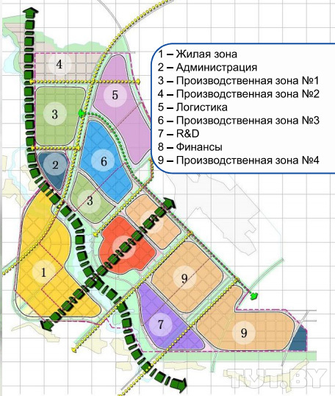
The Great Stone Industrial Park¹⁰
After 2013, it becomes
more logical

Slide 8
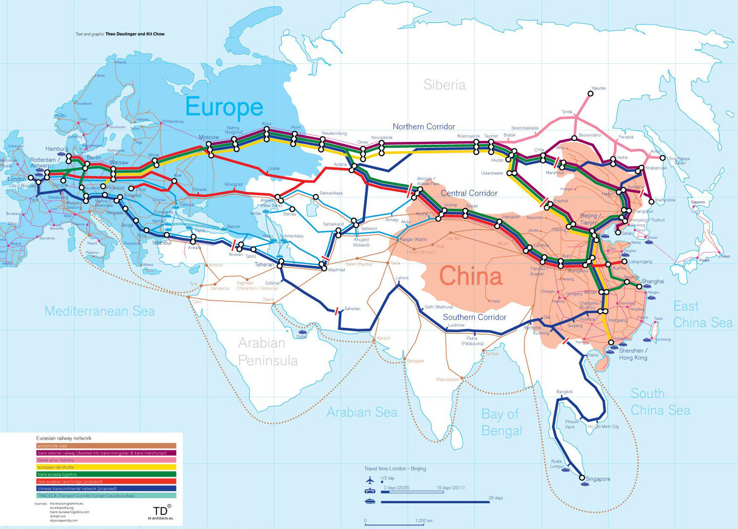
The One Belt, One Road Project¹¹

Slide 9
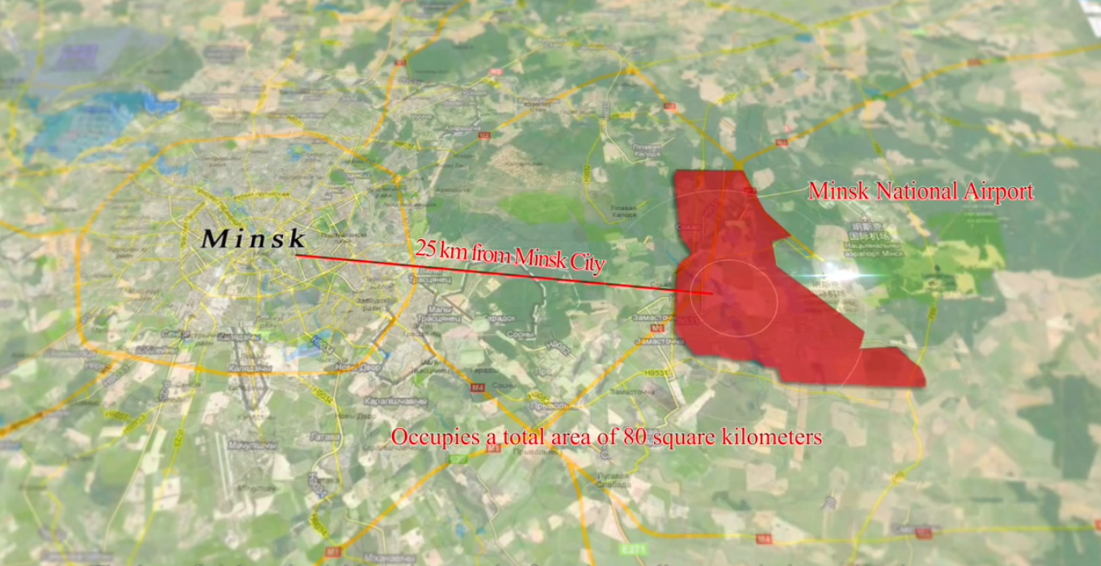

Slide 10
The Pessimist’s Narrative (Jelisiejeŭ 2013)
“Belarusian authorities have become victims of their own propaganda”¹²
Chinese diplomats compared to “Nigerian Spammers”¹³
China has better comparative gains in Russia, Europe and the EU¹⁴
Relations essentially dead in the water¹⁵
Critique: relations continue to move forward¹⁶

Slide 11
The Pragmatist’s Narrative (Šrajbman 2014)
Great risks for conditional rewards¹⁷
Main problem in Belarus–China relationship: Belarus expects to gain from China¹⁸
No political conditionality; instead, commercial conditionality (tied assistance)
Belarus committed to high-risk strategy
Critique: lacks geopolitical scope

Slide 12
The Geopolitical Narrative (Jakoŭčyk 2015)
Stabiliser between Russia and EU¹⁹
Chinese non-intervention and conditionality free assistance is non-threatening
Reduces Western influence and contributes to growing authoritarian presence (?)
Critique: (a) misunderstands the development of relations²⁰
(b) inaccurately describes China’s intentions²¹
(c) not quite unconditional²²

Slide 13
Synthesis of the Four Narratives
The official narrative: Belarus is China’s foothold to Europe (there is potential)²³
The pessimistic narrative: caution and scepticism are needed to gauge relations²⁴
The pragmatic narrative: great risks for conditional rewards²⁵
The geopolitical narrative: (a) Balancing between Russia and EU; (b) authoritarian presence on Eastern border of EU²⁶

Slide 14
Applying the Synthesis of Narratives to Future Research
How Belarusian regime is attempting to use ties with China to promote stability and remain in power (geopolitical narrative)
Chinese President Xi Jinping promised to make Belarus a central hub on the OBOR (pragmatic narrative)
The trade imbalance continues to grow and direct investment is still absent (pessimist), but China still offers loans and assistance (pragmatic)

Slide 15
Conclusion
Four Differing Narratives
Each narrative has something to give
A synthesis of narratives is the most productive understanding
Bilateral ties continue to develop

Slide 16
Notes
See Manyonok (2016, February 15) and Khodasevich (2016, October 3).
See BelTA (2016, September 30).
Alexei Maslov, a Russian orientalist, says “[The Kremlin has] concerns that Belarus may become part of China’s big arc of influence bypassing Russia.” See Melinkova (2016, October 4). Also see Yakouchyk (2015).
See Yeliseyev (2013).
See Korosteleva (2011, 571).
See Yeliseyev (2013).
See Xinhua (2010).
See TUT.by (2014).
See Smok (2014) and TUT. By (2014).
See Dudina (2013 et al.).
See TD Architects (2011).
See Astapenia (2014).
See Sverdlov and Chalyi (2014, February 23).
See Yeliseyev (2013).
See Yeliseyev (2013) and Klaskovskii, A. (2016, September 29).
See See Manyonok (2016, February 15), Khodasevich (2016, October 3) and Melinkova (2016, October 4).

Slide 17
Notes continued…
17. Yeliseyev (2013) and Klaskovskii, A. (2016, September 29).
18. Shraibman (2014).
19. Yakouchyck (2015).
20. Yeliseyev (2013) clearly shows it is Belarus that has sought China’s presence in Belarus, not the other way around.
21. See Bader (2015).
22. See Shraibman (2014).
23. See Ablaza (2016, September 30).
24. See Khodasevich (2016, October 3).
25. See Manyonok (2016, February 15). However, it should be noted that larger loans and more favourable terms would be hard to find (Melinkova 2016, October 4).
26. See Thornton and Ilin (2015, Feburay 24).

Slide 18
Bibliography
Ablaza, A. (2016, September 30). China and Belarus Renew Ties During Lukashenko’s Visit to Beijing. YIBADA. Retrieved from: http://en.yibada.com/articles/164071/20160930/china-belarus-renew-ties-during-lukashenko-s-visit-beijing.htm.
Astapenia, R. (2014). Belarusian-Chinese Relations: From Great Promise To Failure. Belarus Digest. Retrieved from: http://belarusdigest.com/story/belarusian-chinese-relations-great-promise-failure-17444.
Bader, J. (2015). China, Autocratic Patron? An Empirical Investigation of China as a Factor in Autocratic Survival. International Studies Quarterly, 59, 23–33. DOI: 10.1111/isqu.12148.
BelTA. (2016, September 30). Lukashenko names most important factor in Belarus-China friendship. BelTA. Retrieved from: http://www.belarus.by/en/press-center/speeches-and-interviews/lukashenko-names-most-important-factor-in-belarus-china-friendship_i_0000046497.html.
Bohdan, S. (2015). China As An Epic Failure Of Belarusian Foreign Policy. Belarus Digest. Retrieved from: http://belarusdigest.com/story/china-epic-failure-belarusian-foreign-policy-23225.
Dudina, G., Kuznetsova, O., and Strokan’, S. (2013, July 16). “Aleksandr Lukashenko otkryvaet Rossiiu dlia Kitaia” [Alexander Lukashenka is opening up Russia for China]. Retrieved from: http://www.kommersant.ru/doc/2234624.
Khodasevich, A. (2016, October 3). “Lukashenko vybiraet Pekin” [Lukashenko Chooses Beijing]. Nezivisimaya Gazeta. Retrieved from: http://www.ng.ru/cis/2016-10-03/6_belorussia.html.
Klaskovskii, A. (2016, September 29). “Lukashenko v Kitae. Pochemu ne udalos’ osedlat’ drakona?” [Lukashenka Versus China: Why Has He Failed to Harness the Dragon.” Naviny.by. Retrieved from: http://naviny.by/article/20160929/1475170486-lukashenko-v-kitae-pochemu-ne-udalos-osedlat-drakona.
Korosteleva, E. (2011). Belarusian Foreign Policy in a Time of Crisis. Journal of Communist Studies and Transition Politics, 27: 3-4, 566–586. DOI: http://dx.doi.org/10.1080/13523279.2011.595167.
Manyonok, T. (2016, February 15). “Gde ‘zastriali’ kitaiskie milliardy” [Where the Chinese Billions Have Been Held Up]. Belrynok. Retrieved from: http://www.belrynok.by/ru/page/economics/2520/.
Melinkova, K. (2016, October 4). “Belarus may become China’s foothold in Eastern Europe”. EurAsia Daily. Retrieved from: https://eadaily.com/en/news/2016/10/04/belarus-may-become-chinas-foothold-in-eastern-europe.
Shraibman, A. (2014). “Belorussko-kitaiskie otnosheniia: ozhidaniia, problemy i perspektivy” [Belarus-China Relations: Expectations, Problems and Outlooks] (Report No. 2014). Retrieved from the Friedrich Ebert Stiftung Foundation: Ukraine Bureau: http://library.fes.de/pdf-files/bueros/ukraine/11022.pdf.
Smok, V. (2014). Kiryl Rudy Wants To Attract Emigrants Back To Belarus. Belarus Digest. Retrieved from: http://belarusdigest.com/story/kiryl-rudy-wants-attract-emigrants-back-belarus-17041.
Sverdlov, P. and Chalyi, S. (2014, February 23). “‘Ekonomika na pal’tsakh’. K chemu privedet rasprodazha skladov po tsene nizhe sebestoimosti i pochemu ona khuzhe deval’vatsii” [Economics Made Easy: Why They Are Selling State Goods At Less Than Cost and Why This Is Worse Than Devaluation]. Retrieved from: http://news.tut.by/economics/387538.html.
TD architects. (2011). The Iron Silk Road, Mapping Cultural Space Across Eurasia. Retrieved from: http://eurasia.cga.harvard.edu/items/show/964.
Thornton, G. M. and Ilin, A. (2015, Feburay 24). The real winner of the Ukraine crisis could be China. The Washington Post. Retrieved from: https://www.washingtonpost.com/posteverything/wp/2015/02/24/the-real-winner-of-the-ukraine-crisis-could-be-china/.
TUT.BY. (2014, February 14). “Lukashenko pro tempy stroitel’stva Kitaisko-belorusskogo industrial’nogo parka: ‘Eto eshche odno bezobrazie so storony pravitel’stva’” [Lukashenka on the tempo of construction of the China–Belarusian Industrial Park: ‘It’s another disgrace on behalf of the government]. TUT.BY. Retrieved from: http://news.tut.by/economics/386790.html.
Xinhua. (2010). China is Best Friend of Belarus. Xinhua News Agency. Retrieved from: http://news.xinhuanet.com/english2010/indepth/2010-10/09/c_13549124.htm.
Yakouchyk, K. (2015). The good, the bad, and the ambitious: democracy and autocracy promoters competing in Belarus. European Political Science Review, January, 1–30. DOI: 10.1017/S1755773914000459.
Yeliseyev, A. (2013). Some Aspects of Belarusian-Chinese Relations in the Regional Dimension: Much Sound and Little Sense (Report No. SA #08/2013RU, 9 April, 2013). Retrieved from the Belarusian Institute for Strategic Studies: http://belinstitute.eu/sites/biss.newmediahost.info/files/attached-files/BISS_SA08_2013en.pdf.

