Slide 1
In Search of a Third Wing? Belarus–China Relations and Balancing Amid the Russia–Ukraine Conflict
By Peter Braga
March 24, 2016

Slide 2
This is a presentation on the nature of China–Belarus relations and impact of the Ukraine Crisis on political balancing in the region.
I will argue:
The relationship is indeed “more hype than substance,” but China will continue to give its calculating assitance
The Ukraine crisis has aided Belarus's balancing of its east–west FP
Finally, Russian belligerence and aggression encourages Belarus to seek closer ties with China.

Slide 3
This presentation is divided into 4 parts
Background info on China–Belarus relations
The nature of Belarus–China relations
The impact of the Ukraine crisis on Belarus–China relations
Then it considers Russia and regional balancing.

Slide 4
Background Info
China–Belarus relations are mostly irrelevant until 2006.
In late December 2005, Belarus and China signed a Joint Declaration, which markedly improved bilateral cooperation and interaction.
Russian gas prices and tariffs were going to be 'pragmatized'
(Korosteleva 2011, 571);

Slide 5
The Nature of Belarus China Relations
Differing interpretations
Industrial Park: “The Symbol of Belarus–China Relations.”
The Chinese Belarus relationship is imbalanced and Belarus takes the greatest risk

Slide 6
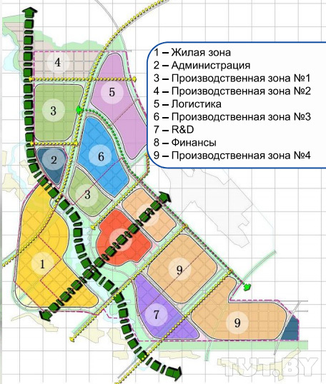

Slide 7
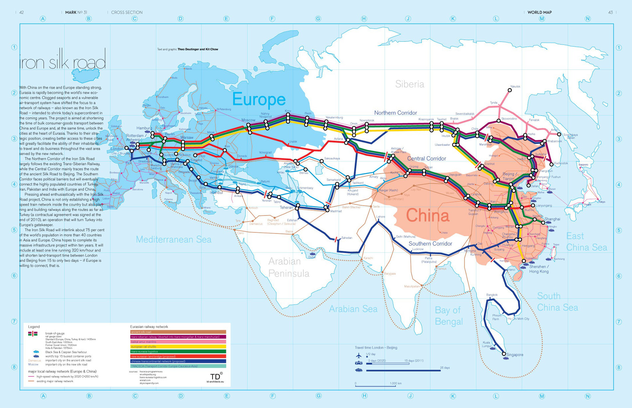

Slide 8
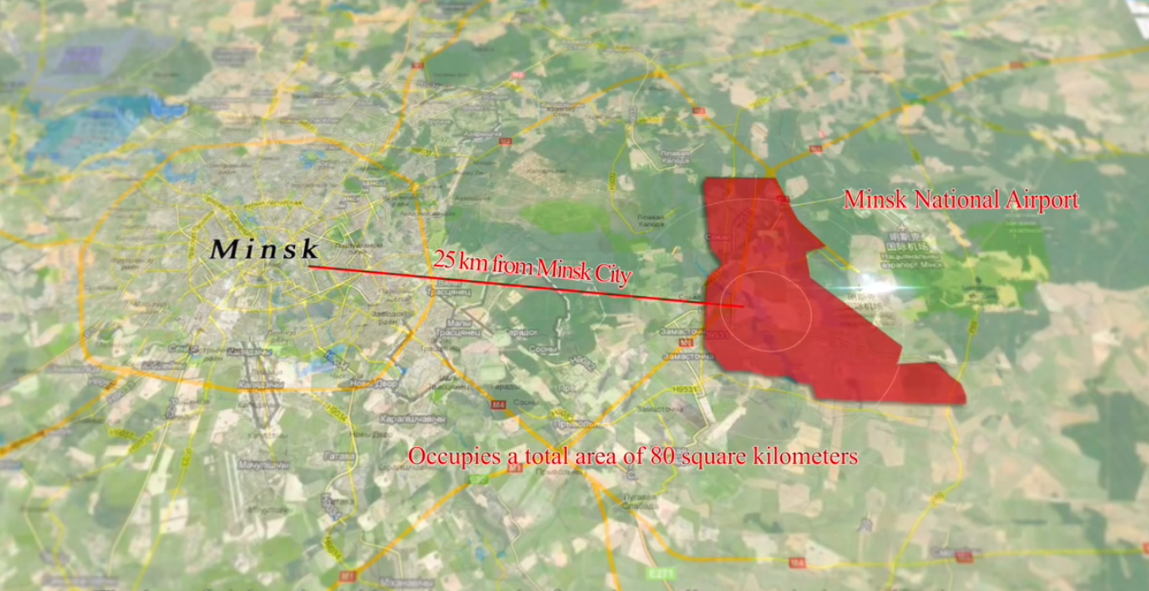

Slide 9
The Nature of Belarus China Relations: Summary
China belatedly sees that Belarus holds geographic potential.
China is continuing to invest in Belarus, which indicates a growing commitment to Belarus.
However, this is only possible if Belarus takes on the risk and works according to China's terms.

Slide 10
The Ukraine Crisis: The Impact for Belarus and China Relations
Russian aggression encourages Belarus to deepen external ties
Aids rebalancing to West; Potentially improves attractiveness to China
Chinese “strategic ambiguity”
Good China–Russia relations rationalize Belarus as a gate to Europe

Slide 11
Balancing With Russia
China gives Belarus a small breathing space
No panacea: Russia still needs to be negotiated with, over China and aid
Reduced Western Leverage
Too early to speak about Linkages with West

Slide 12
Conclusion
Minsk has escaped political conditionality, but not commercial conditionality
Belarus has taken on a high risk policy with China in an attempt to remain unreformed
Greatest risk: Just another transit hub?
The relationship continues to develop…

