Slide 1
Russian, Ukrainian and Belarusian relations with China, 2006–2016: Regional Balancing & Authoritarian Persistence
Peter Braga
December 15, 2016

Slide 2
Outline
Focus on 4 Aspects of My Research:
The Argument: Regional Balancing & Authoritarian Persistence
The Approach: Three Strategies
The Methodology: A Mixed Bag
Potential Problems: Arguments and Action Plans
Notes:
This Presentation will focus on four aspects of my research:
(1) My argument, which puts forward my research puzzle and identifies my dissertation’s core concepts: regional balancing and authoritarian persistence.
(2) My approach, which lays out how I will frame and interpret this research puzzle.
(3) My methodology, which are the tools I will use to gather and answer the data necessary to answer my research questions.
(4) Finally, I will share some potential issues and pitfalls I foresee in path of my research.

Slide 3
Main Aim of Research
Do Russia, Ukraine and Belarus use their bilateral ties with China to enhance authoritarian persistence?
What is authoritarian persistence?
How regimes use their position within the international system to promote internal stability and prolong non-democratic domestic rule.
Notes:
My research puzzle, or the main aim of my research, is to investigate whether or not Russia, Ukraine and Belarus use their bilateral relations with China to enhance authoritarian persistence?
The timeframe for my research is 2006–2016. I use this timeframe for two reasons: (1) it corresponds to China’s “Go Global” campaign; (2) and a convergence of policy among Russia, Ukraine and Belarus to deepen ties with China.
Moldova is not included in the group, because Moldova’s diplomatic and economic relations with China are negligable.

Slide 4
Who cares?
Applies a new perspective to understand changing contexts
This study will contribute to existing research
Modest contribution to unbalanced bilateral relations literature
China’s impact on authoritarian persistence understudied
Implications for the European Union and regional relations
Threshold of the OBOR into Europe
Notes:
A new interpretation

Slide 5
Contemporary Context
China’s rise in the region and the world
Global authoritarian revival?
China as an example for authoritarian regimes?
China is “Going Global”

Slide 6
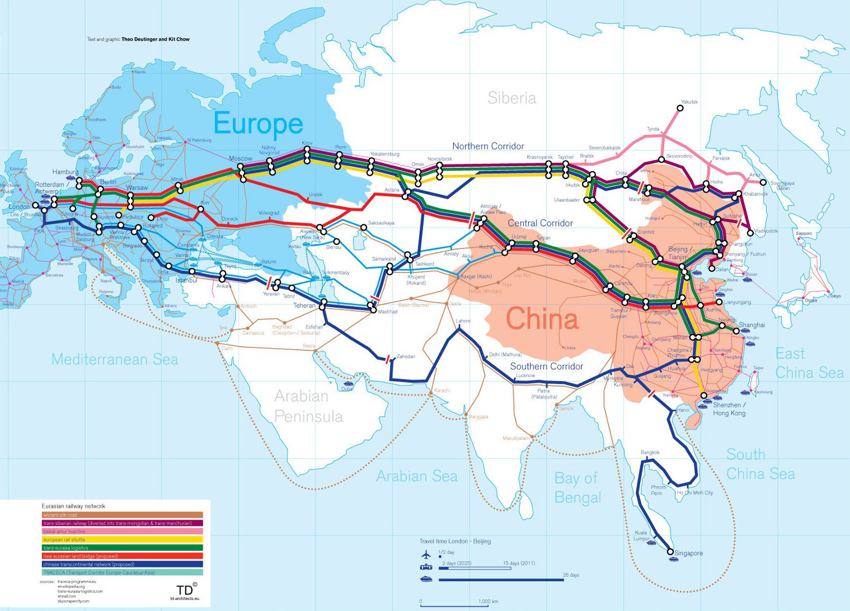
The Silk Road Project
Figure 1: The Silk Road Project. This image has been modified from the original with permission.
Source: TD architects. (2011). The Iron Silk Road, Mapping Cultural Space Across Eurasia. Retrieved from:
http://eurasia.cga.harvard.edu/items/show/964 [accessed December 11, 2016].
Notes:
I should doctor this in InDesign to clearly show the Russian, Ukrainian and Belarusian routes.

Slide 7
Definitions and Theory
China’s Rise and a Changing Context: Balance of Power
Authoritarian + Persistence
Connecting authoritarian persistence to external relations
Selectorate Theory: Winning Coalitions and Staying in Power
By nature, the winning coalition has external interests

Slide 8
Timeframe and Actors
Timeframe: 2006–2016
China’s “Go Global Campaign”
Convergence of interest among actors
Why Russia, Ukraine and Belarus? Why not Moldova?
Why Russia?

Slide 9
Existing Research
Foreign Relations (key studies)
Regional Balancing (Cooley 2013; Snyder 1997; Walt 1991)
R, U, B and China (Gabuev 2016; Lo 2015; Liu 2016; Shraibman 2014)
Authoritarian Persistence
Vanderhill and Aleprete (2013)
Julia Bader (2015a, 2015b)
Development of 3 strategies of authoritarian persistence
Notes:
What are they good for?
What do they do wrong?

Slide 10
Strategy 1 + Methodology
Patronage
Bilateral Ties (interpretive data)
Methodology: Measures depth of relations against regime survival and effectiveness of support
Cox’s proportional hazards model Cox’s proportional hazards model (Everitt and Skrondal 2010, 112)
Similar to Bader’s (2015b) research, but my method includes “effectiveness” (Kindornay 2011, 18–19)
Probit Analysis

Slide 11
Strategy 2 + Methodology
Authoritarian Learning: The China Model
the copying or sharing/trading of policies (formal or informal) promote autocratic regime survival
Methodology: Discourse Analysis (Speeches and Interviews)
“what the Chinese Model looks like when it ‘lands’” (Fourie 2015, 295)
Official Speeches and texts
BUT is praise for China model just lip-service?

Slide 12
Strategy 3 + Methodology
International Coordination (Ambrosio 2009; Vanderhill 2013, 220)
Methodology: cooperation at the international level
Voting behaviour at the United Nations (cohesion among actors) (Yelisiyev 2013; )
Proposals to enhance regime stability within the Shanghai Cooperation Organisation (Ambrosio 2009)

Slide 13
Potential Problems
Negative Results
Adjusting the Strategies
Outliers: Russia and Ukraine
Originality?
Notes:
Should I email Julia Bader? Would this be a bad idea?

Slide 14
Research Timeline
Pre-Upgrade (development of bilateral relations: case studies)
Testing Phase—statistical models (the first and third strategies)
Research Phase (gathering and analysing data)
Writing Phase

Slide 15
References
TD architects. (2011). The Iron Silk Road, Mapping Cultural Space Across Eurasia. Retrieved from: http://eurasia.cga.harvard.edu/items/show/964 [accessed December 11, 2016].
Cooley, A. (2012). Great Games, Local Rules: The New Great Power Contest in Central Asia. New York: Oxford University Press.
Snyder, G. (1997). Alliance Politics. Ithaca, NY: Cornell University Press.
Walt, S. (1990). The Origins of Alliances. Ithaca, NY: Cornell University Press.
Gabuev, A. (2016a). A Pivot to Nowhere: The Realities of Russia’s Asia Policy. The Carnegie Moscow Center. Retrieved from: http://carnegie.ru/commentary/2016/04/22/pivot-to-nowhere-realities-of-russia-s-asia-policy/ixfw.
Lo, B. (2015). Russia and the New World Disorder. Washington, DC: Brookings Institution Press.
Liu, Z. K. (2016). The Analysis of the Relationship between China and Ukraine. CEEC. Retrieved from: http://16plus1-thinktank.com/1/20160111/1095.html.
Shraibman, A. (2014). “Belorussko-kitaiskie otnosheniia: ozhidaniia, problemy i perspektivy” [Belarus-China Relations: Expectations, Problems and Outlooks] (Report No. 2014). Retrieved from the Friedrich Ebert Stiftung Foundation: Ukraine Bureau: http://library.fes.de/pdf-files/bueros/ukraine/11022.pdf.
Bader, J. (2015a). China’s Foreign Relations and the Survival of Autocracies. New York: Routledge.
Bader, J. (2015b). Propping up dictators? Economic cooperation from China and its impact on authoritarian persistence in party and non-party regimes. European Journal of Political Research, 54, 655–672. doi: 10.1111/1475-6765.12082.
Vanderhill, R. (2013). Conclusions: The International Dimension of Authoritarian Persistence. In Rachael Vanderhill and Michael E. Aleprete Jr. (eds), International A252:J418 of Authoritarian Persistence: Lessons From Post-Soviet States (219–229). Plymouth, UK: Lexington Books.
Fourie, E. (2015). China’s example for Meles’ Ethiopia: when development ‘models’ land. The Journal of Modern African Studies, 53, 289-316. DOI:10.1017/S0022278X15000397.
Yeliseyev, A. (2013). Some Aspects of Belarusian-Chinese Relations in the Regional Dimension: Much Sound and Little Sense (Report No. SA #08/2013RU, 9 April, 2013). Retrieved from the Belarusian Institute for Strategic Studies: http://belinstitute.eu/sites/biss.newmediahost.info/files/attached-files/BISS_SA08_2013en.pdf.
Ambrosio, T. (2009). Authoritarian Backlash: Russian Resistance to Democratization in the Former Soviet Union. Farnham: Ashgate.

Slide 16
Q&A Preparations
Slides to prep:
My 3 core concepts
Philosophies underpinning research methods
Detailed explanation-slides of methods for each strategy, including formulas
Regional Justification
Timeframe justification
My research questions
Why I don’t have ethical considerations, logistical issues or high risk worries
Drive home what puzzle my dissertation solves
Is my study reproduceable? Can others use it?

